Slide 1
Notes:
The NASA Carbon Monitoring System (CMS) is a forward-looking initiative designed to make significant contributions in characterizing, quantifying, understanding, and predicting the evolution of global carbon sources and sinks through improved monitoring of carbon stocks and fluxes. Initially implemented in response to language in NASA’s 2010 Congressional Appropriation, this program is now included in NASA’s multi-year budget; the program is currently conducting pre-Phase A and pilot initiatives for the development of a carbon monitoring system. Today the CMS is comprised of over 65 projects deployed over a range of locations, spatial scales, technologies, and stakeholder needs for carbon data. Here we present one advanced prototype, “High resolution carbon monitoring and modeling”. This project will generate the most current accurate, high resolution monitoring and modeling of above ground carbon over scales ranging from the local to regional, and holds promise for future application over global scales.

Slide 2
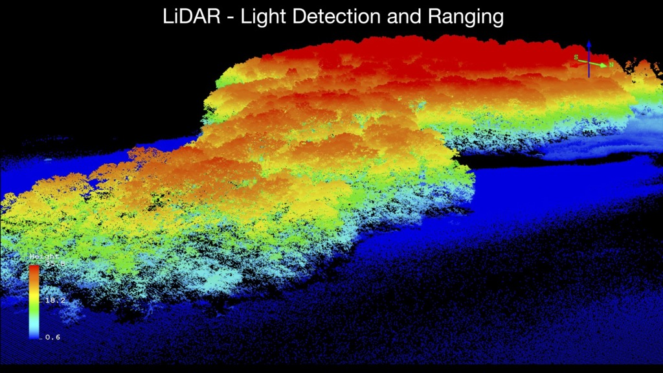
Notes:
For context, land carbon is an important and highly uncertain quantity in the global carbon budget, and thus presents a major challenge to policy efforts. If we look back just 30 years, land carbon was mapped at coarse spatial resolution of approximately 50km, and in just 32 broad categories. Since then tremendous advances have been made in remote sensing, and this has recently has led to the the ability to effectively image the 3-D structure of forests. Key to this technology is LiDAR, or Light Detection And Ranging measurement, an active measurement made from planes or satellites and used to acquire distance measurements of vegetation structure. These measurements are precise enough to effectively capture the 3-D structure of the vegetation as seen in this slide. This image is looking down on a patch of deciduous forest, with colors indicating different heights, red for tall and blue for low. You can clearly see the forest canopy, and in some cases you can see understory vegetation and even make out individual trees.

Slide 3
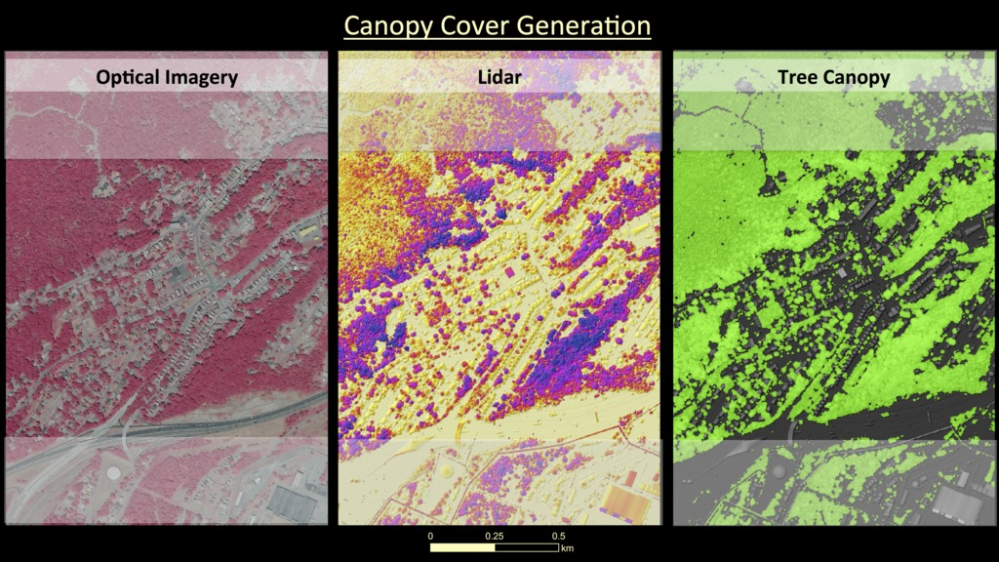
Notes:
Optical, lidar, tree canopy, high-res local scale
Combining high resolution optical imagery of the landscape with corresponding lidar-based measurements of vegetation height makes it possible to identify forest canopy cover and structure with unprecedented accuracy and resolution. Highlighted here is an urban/suburban area in northern Maryland. One can clearly see roads, buildings, and with the help of lidar even extract tree canopy and height information.

Slide 4
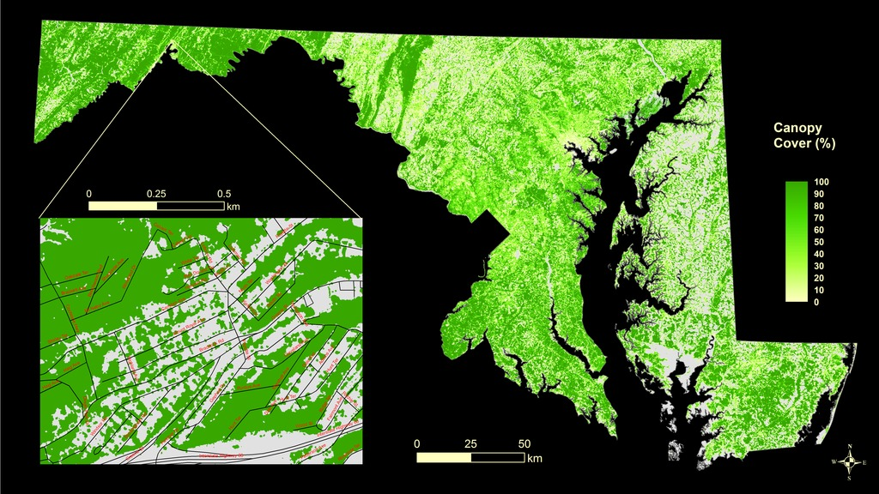
Notes:
Forest canopy cover state
Our remote sensing and computing capabilities allow us to monitor this same high level of detail over much larger regions. Shown here is forest canopy cover for the entire state of Maryland at 30m resolution, again with an urban/suburban area in northern Maryland highlighted. The data clearly shows both state-wide patterns and totals, as well as at a more detailed local or even neighborhood scale. These products are being developed and used In support of state’s 2013 Forest Protection Act which sets a minimum limit on forest cover for the state.

Slide 5
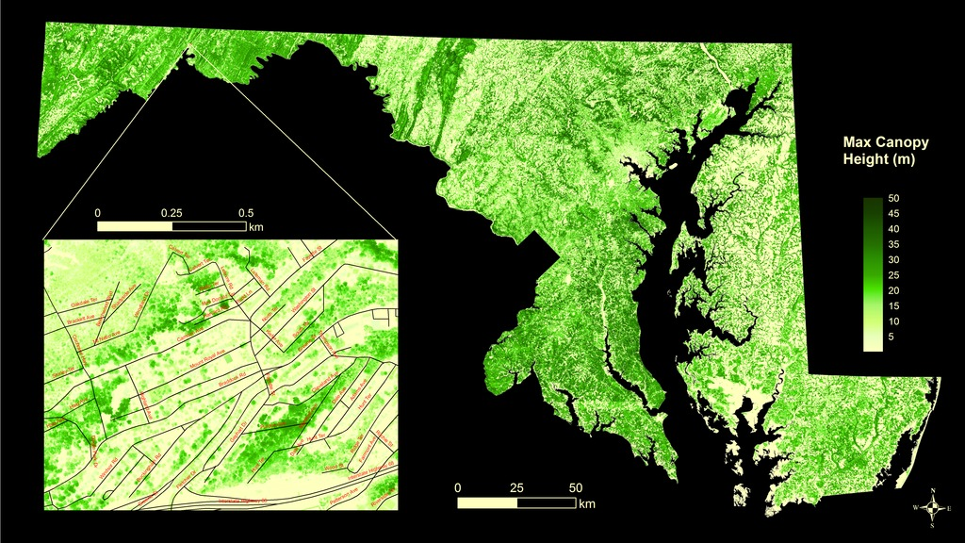
Notes:
Max Canopy Height state
Lidar allows us to map vegetation height statewide at 30m resolution, as seen in this figure of the maximum canopy height of forests. Here we can see not just the extent of forests, but critically the height of forests as well. This information is essential for estimating carbon in forests. Simply put, tall forests generally weigh more and store more carbon than short forests.

Slide 6
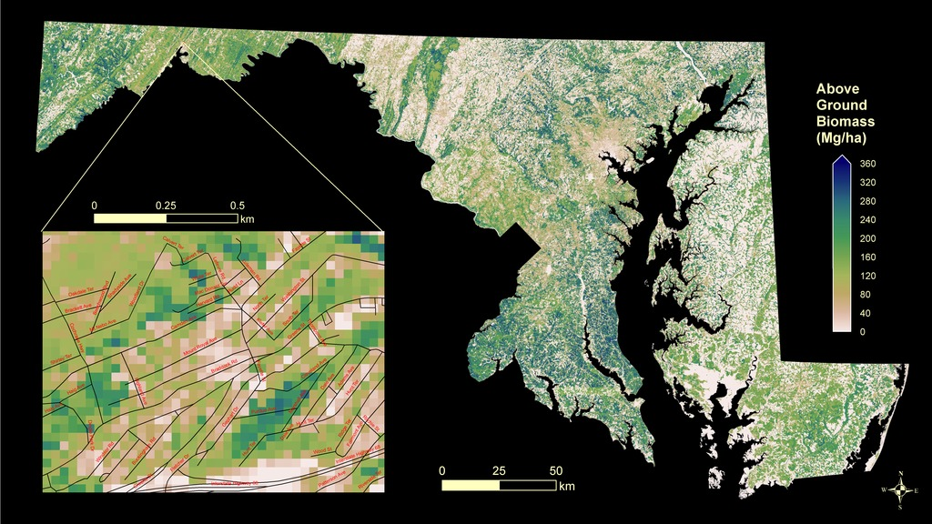
Notes:
ABG empirical state
By combining these mapped data products on forest extent and height with field measurements of individual trees in plots, it is possible to develop statistical models to estimate and map the carbon content of forests. This map shows forest above ground biomass at 30 m resolution over the state. It is possible to aggregate this data to generate state-wide totals, while at the same time see with high enough spatial resolution to estimate carbon at very local scales. This map can also be used to estimate the potential loss of carbon from alternative land-use options that may displace forests, before they even occur.

Slide 7
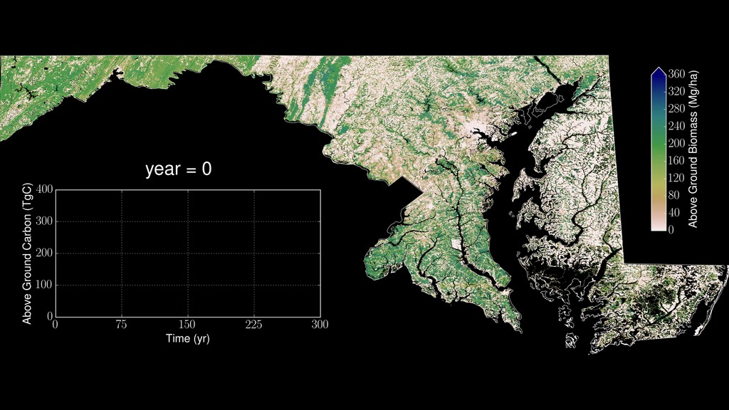
Notes:
Video: http://carbon.nasa.gov/hyperwall/hurtt/6_AGB_MD_300yrs_every_5_yrs_90m_1080p.mp4
AGB model state movie
Integrating all of this data into predictive models allows for the development of new products to estimate the increase in carbon gained from potential afforestation and changes in forest management, as well as how long this accumulation could take. As the data shows, there is approximately 100 Tg of carbon above ground in Maryland’s forests now. As the animation moves forward, we can see the predicted carbon sequestration potential for the state and the estimated time frame to realize that potential. One can see that the state’s potential is about 300 Tg carbon, reaching half that in approximately 75 years, and the full potential in 300 years.
This is simply the potential statewide, and the real value of this product is the very high resolution that will allow identification of the precise subset of areas within the state where it makes the most sense to afforest or restore carbon. These products are being developed for input to the state’s 2016 Greenhouse Gas Reduction Act which seeks to reduce carbon emissions from the state in the future.
It’s worth noting that the high resolution of the data and computation involved represent truly unprecedented effort. With more than 3 million grid cells in the state, the computation involved in these estimates is more than 50 times those used in standard global carbon modeling studies, for an area only a fraction in size.

Slide 8
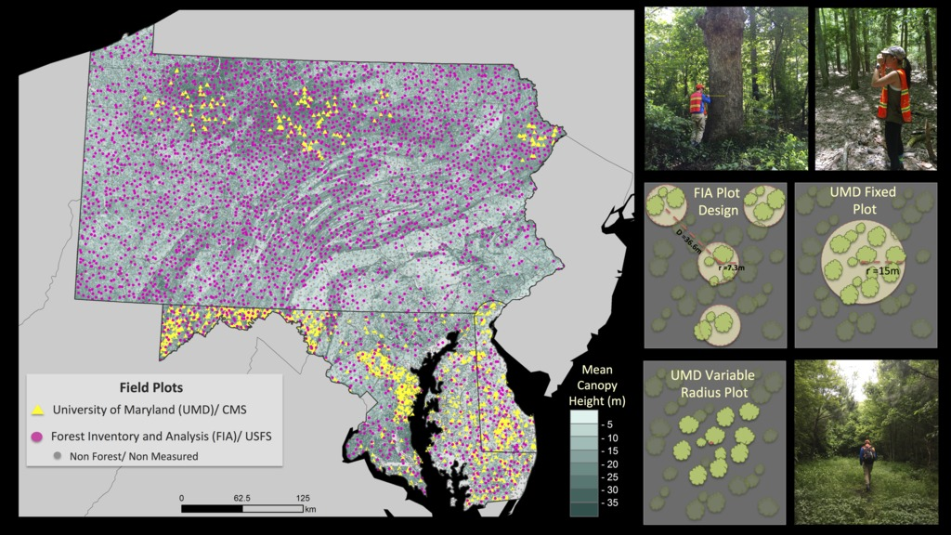
Notes:
Cal/Val, tri-state
While the combined high resolution and broad coverage of these products is unprecedented, we are scaling them up to even larger areas. Since the accuracy of the data is critical, in order to calibrate and validate these products we have employed thousands of Forest Service and additional field pilots over Maryland and the larger Maryland-Pennsylvania-Delaware tri-state area to verify the estimates with the best on-the-ground measurements.

Slide 9
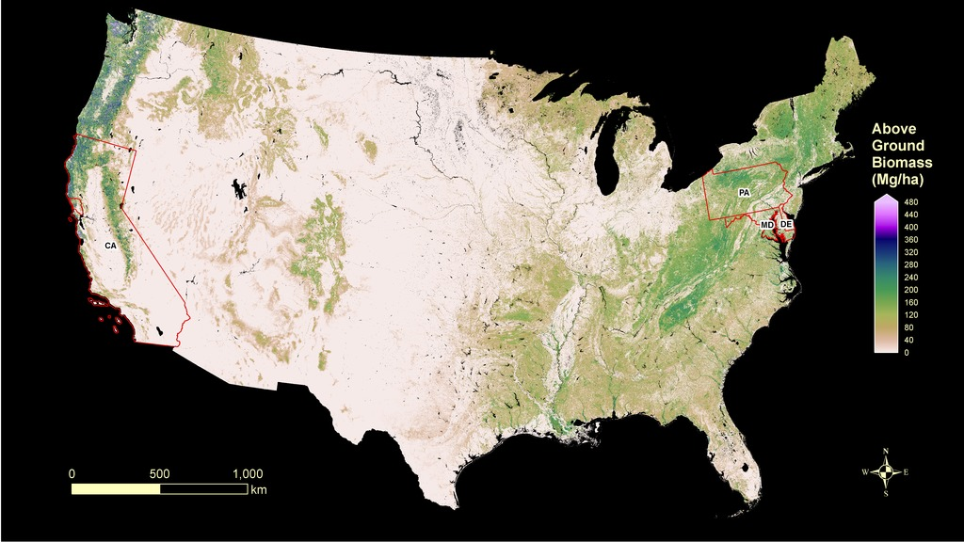
Notes:
Continental map of carbon.
Scaling up even further, NASA has also been able to produce continuous maps of the carbon stored in vegetation over the whole U.S. using existing satellite data. As shown here, green indicates higher levels of storage and light areas lower levels. You can also see the Maryland-Pennsylvania-Delaware tri-state region outlined on this map, as well as a second region in CA-Sanoma county, where the high resolution products presented here are being prototyed. These very high resolution products are also being used to test the coarser national map estimates where the data overlap.

Slide 10
Notes:
GEDI explanation
Finally, scaling up to even larger continental and global scales will require lidar data from space. In the near future, the NASA GEDI mission will use the International Space Station as a platform to capture the key lidar data needed to generate these products over large areas, with a consistent data source and analysis framework.
Acknowledgements:
G. Hurtt (PI), R. Dubayah, K. Dolan, W. Huang, M. Zhao, J. O’Neill Dunne, R. Birdsey, K. Johnson, V. Escobar, E. Sepulveda Carlo, S. Saatchi, D. Lagomasino, D. Stroud, A. Moran, P. Griffith

