Slide 1
Observing methane emissions from space
Daniel Jacob, Joannes Maasakkers, Jianxiong Sheng, Melissa Sulprizio, Alex Turner, Daniel Varon, Lei Zhu (Harvard);
Christian Frankenberg (Caltech); Anthony Bloom, Kevin Bowman (JPL); Yi Huang, Yan Xia (McGill)

Slide 2
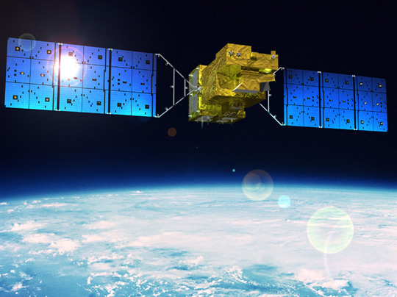
Observing methane emissions from space
Daniel Jacob, Joannes Maasakkers, Jianxiong Sheng, Melissa Sulprizio, Alex Turner, Daniel Varon, Lei Zhu (Harvard)
Christian Frankenberg (Caltech)
Anthony Bloom, Kevin Bowman (JPL)
Yi Huang, Yan Xia (McGill)

Slide 3
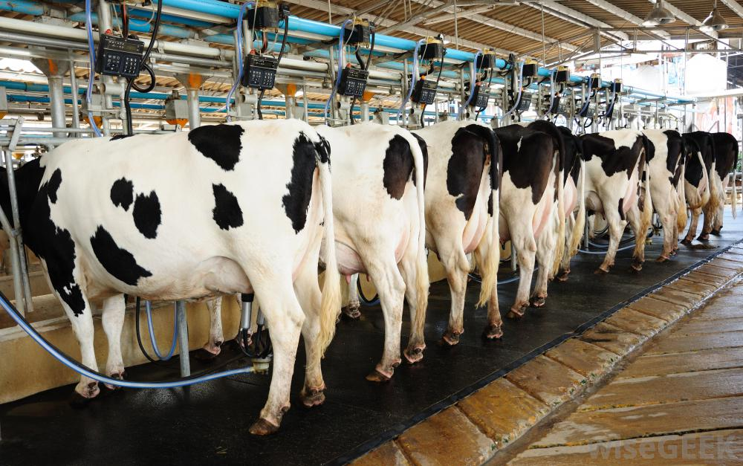
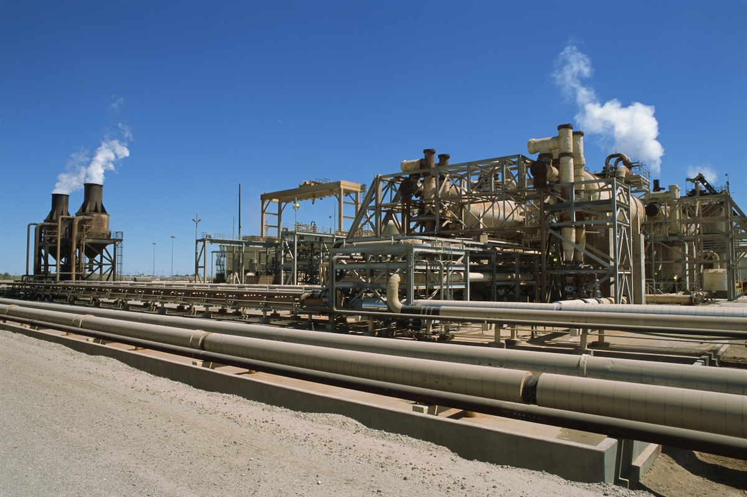
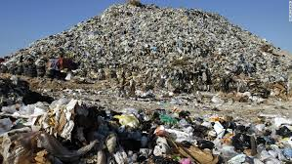
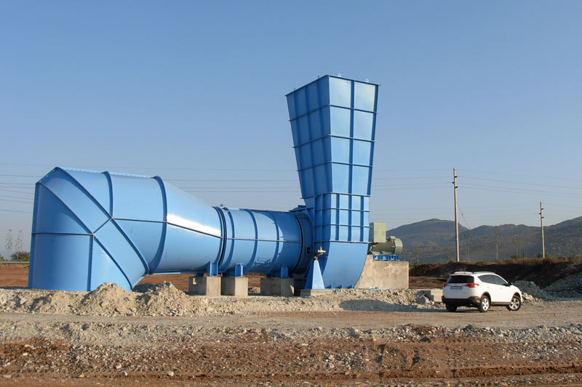
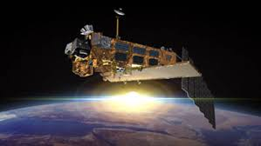
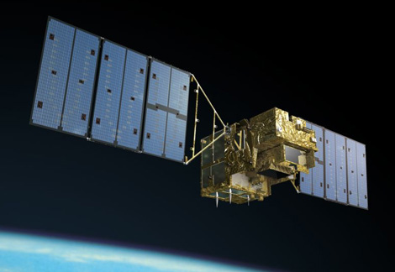
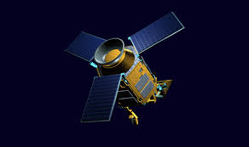
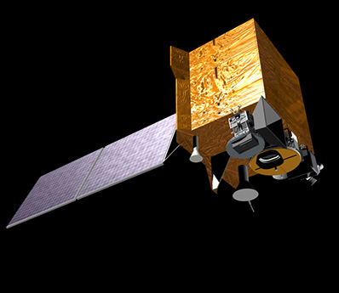
Methane is a major greenhouse gas… but where does it come from?
Satellite observations hold the key!
SCIAMACHY GOSAT TROPOMI GCIRI (geostationary)
2003-2010 2009-present 2017 launch Proposed
Notes:
Sources of methane. Methane is the second most important anthropogenic greenhouse gas after carbon dioxide. Its concentration has nearly tripled since pre-industrial times and we still don't understand why. Wetlands are the main natural source. Major human sources include livestock, oil and gas activities, landfills, coal mine venting, and rice paddies. Satellites provide a unique resource to detect and quantify methane emissions and their changes by measuring atmospheric methane globally and continuously with fine spatial resolution. This presentation illustrates the capabilities of the two principal satellite instruments flown so far, SCIAMACHY (2003-2012) and GOSAT (2009-present). It also describes other ongoing efforts to better understand the sources of methane, and shows the potential of future satellite observations from the TROPOMI instrument (to be launched in 2017) and the geostationary GCIRI instrument (in the proposal stage at NASA).

Slide 4
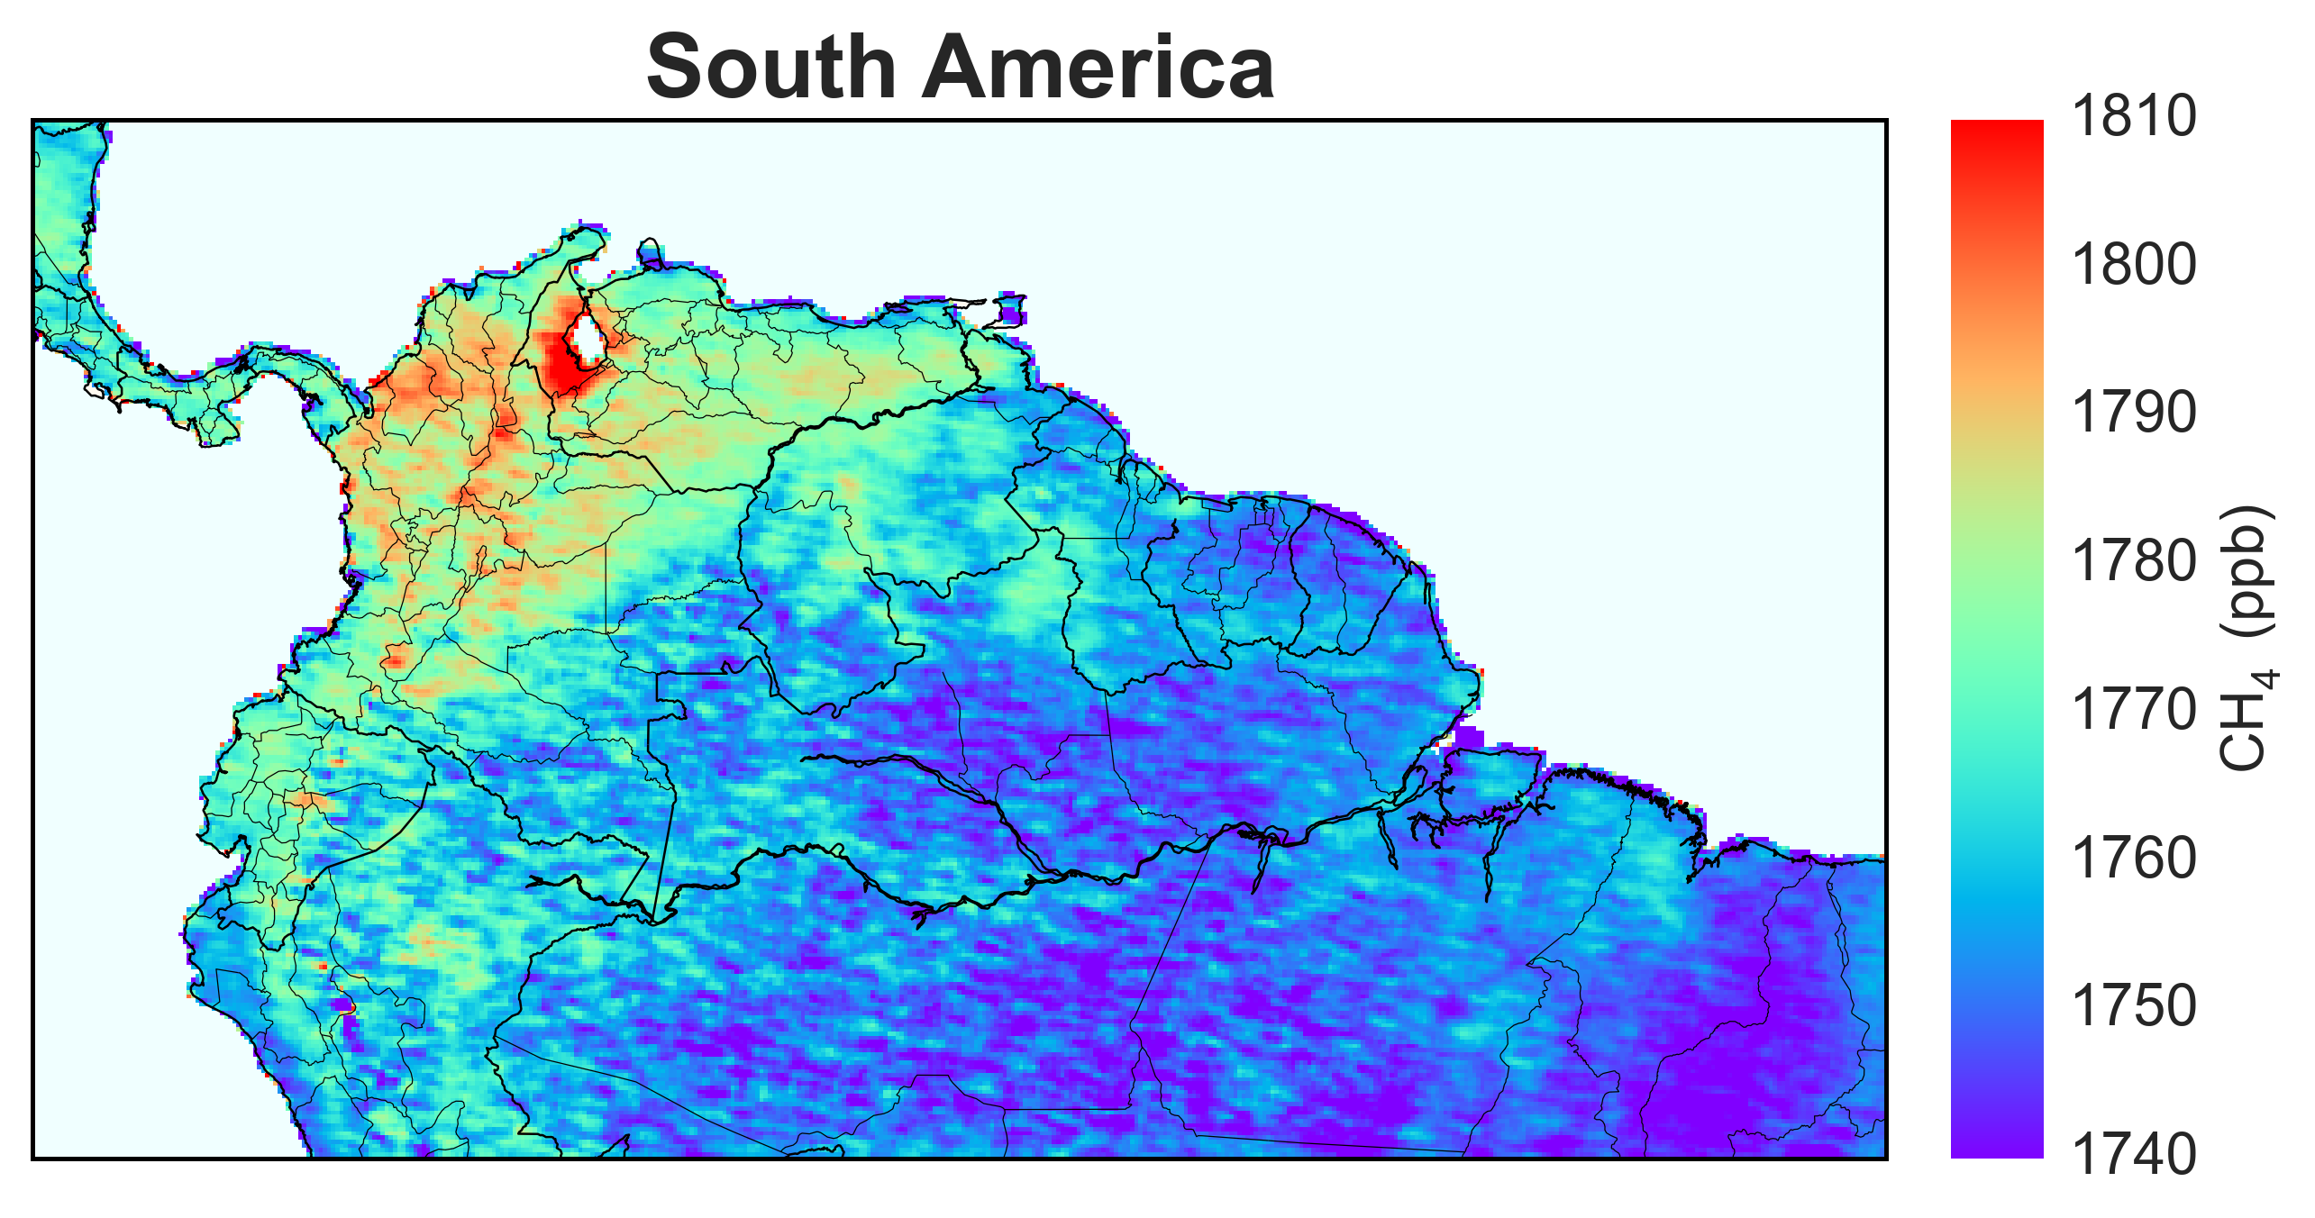
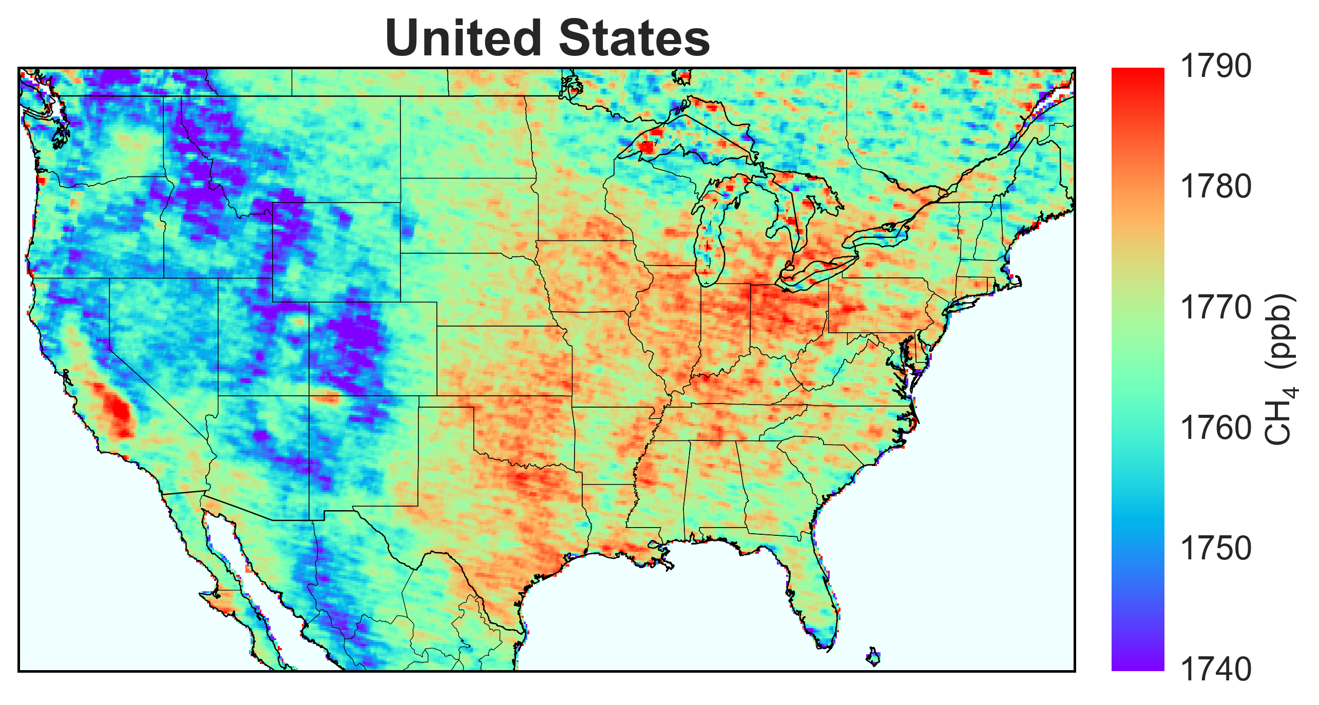
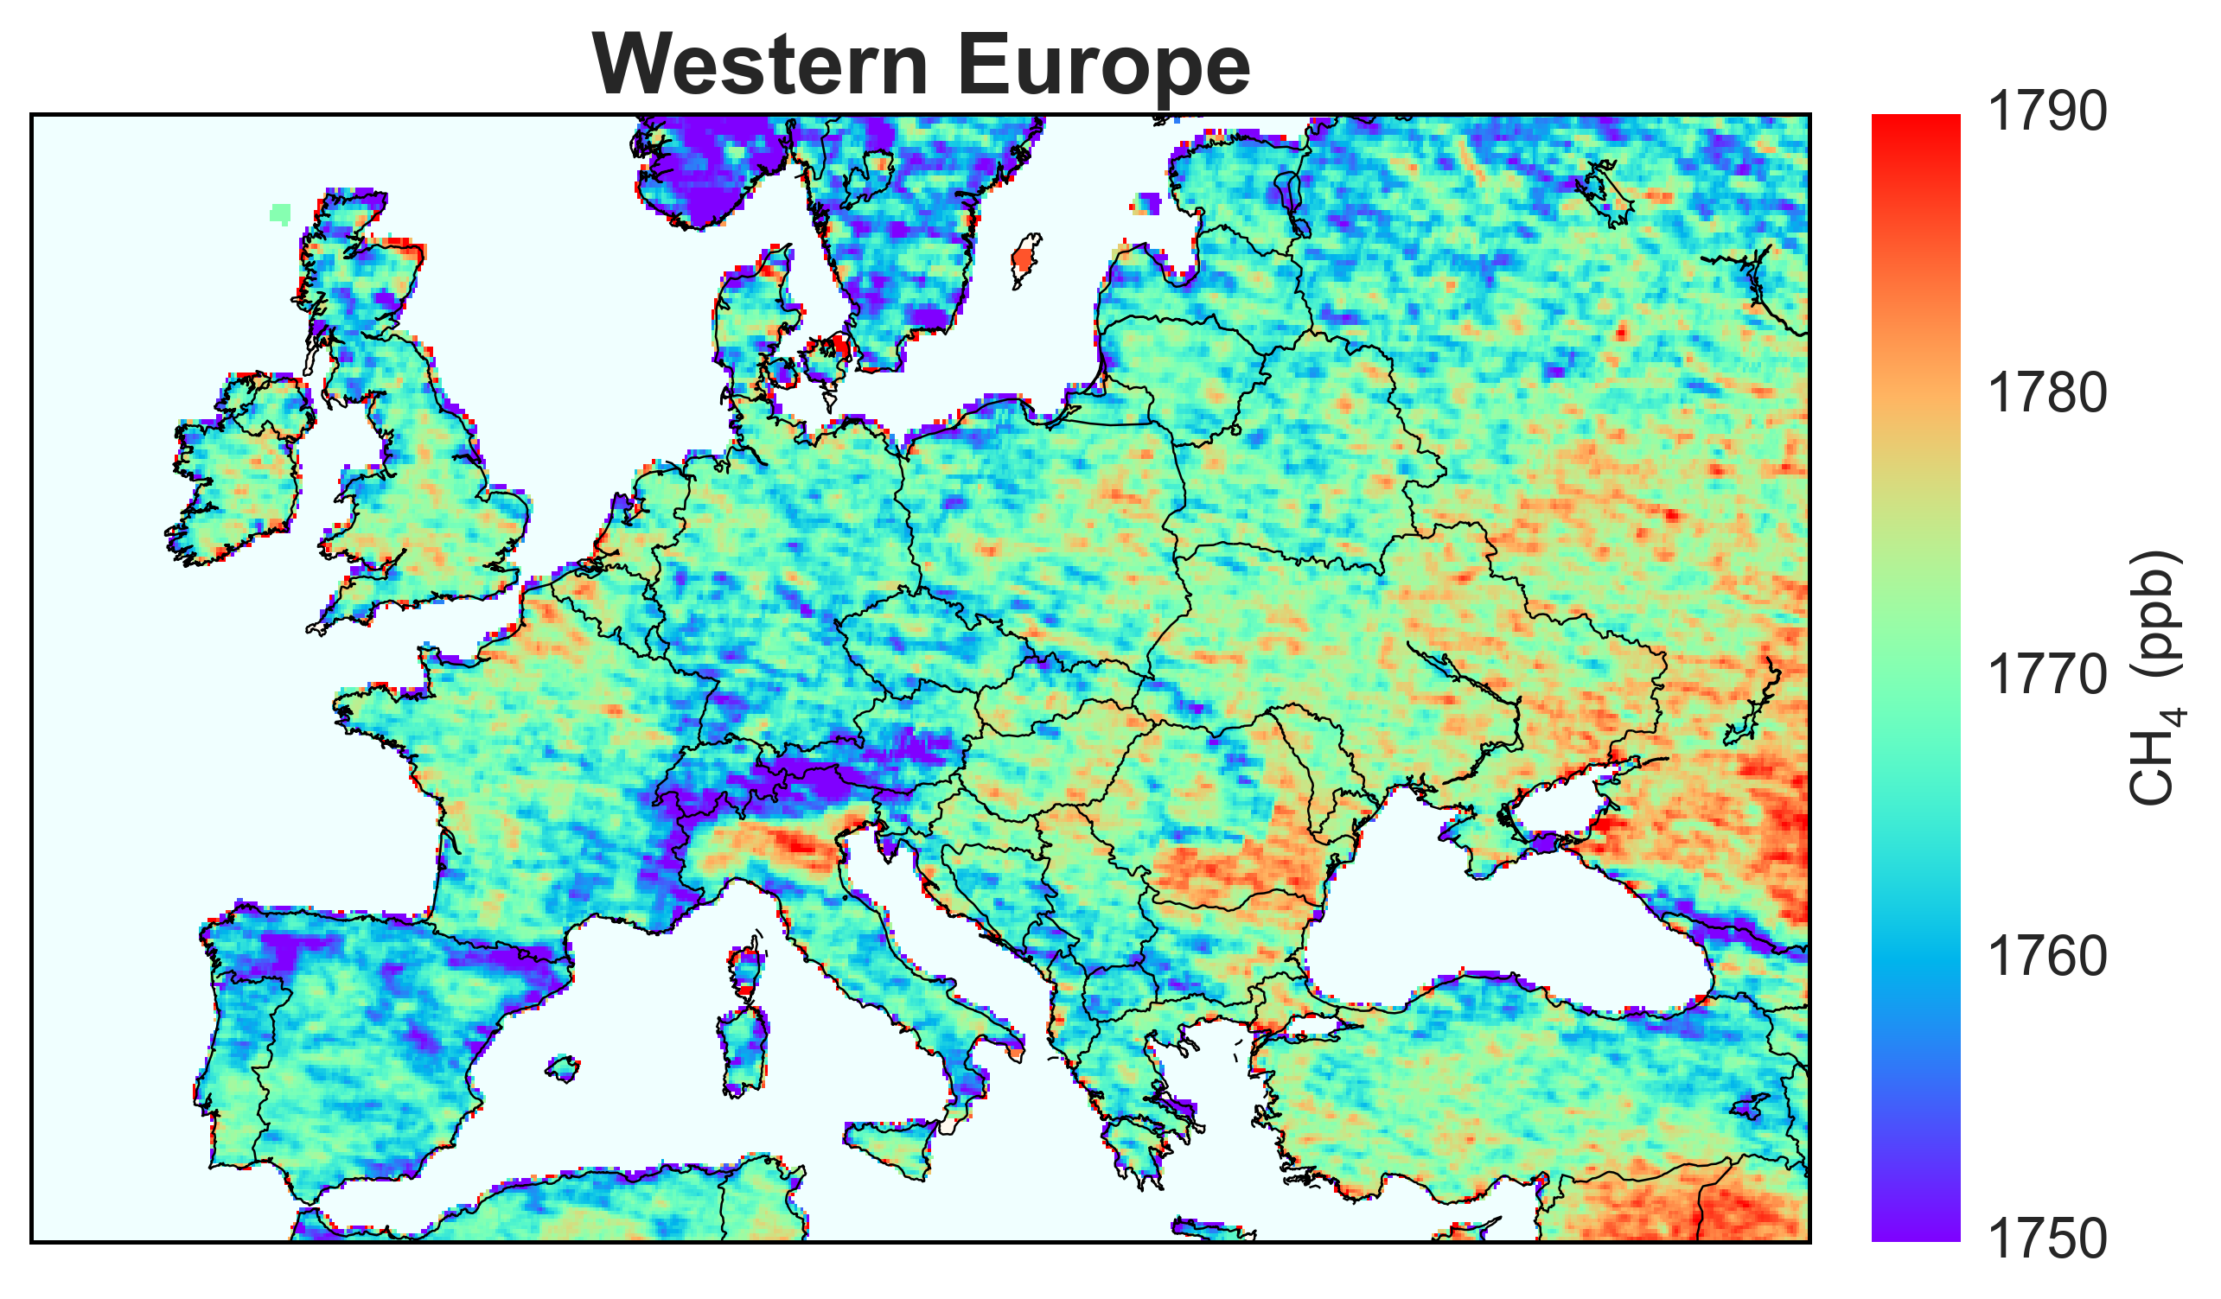
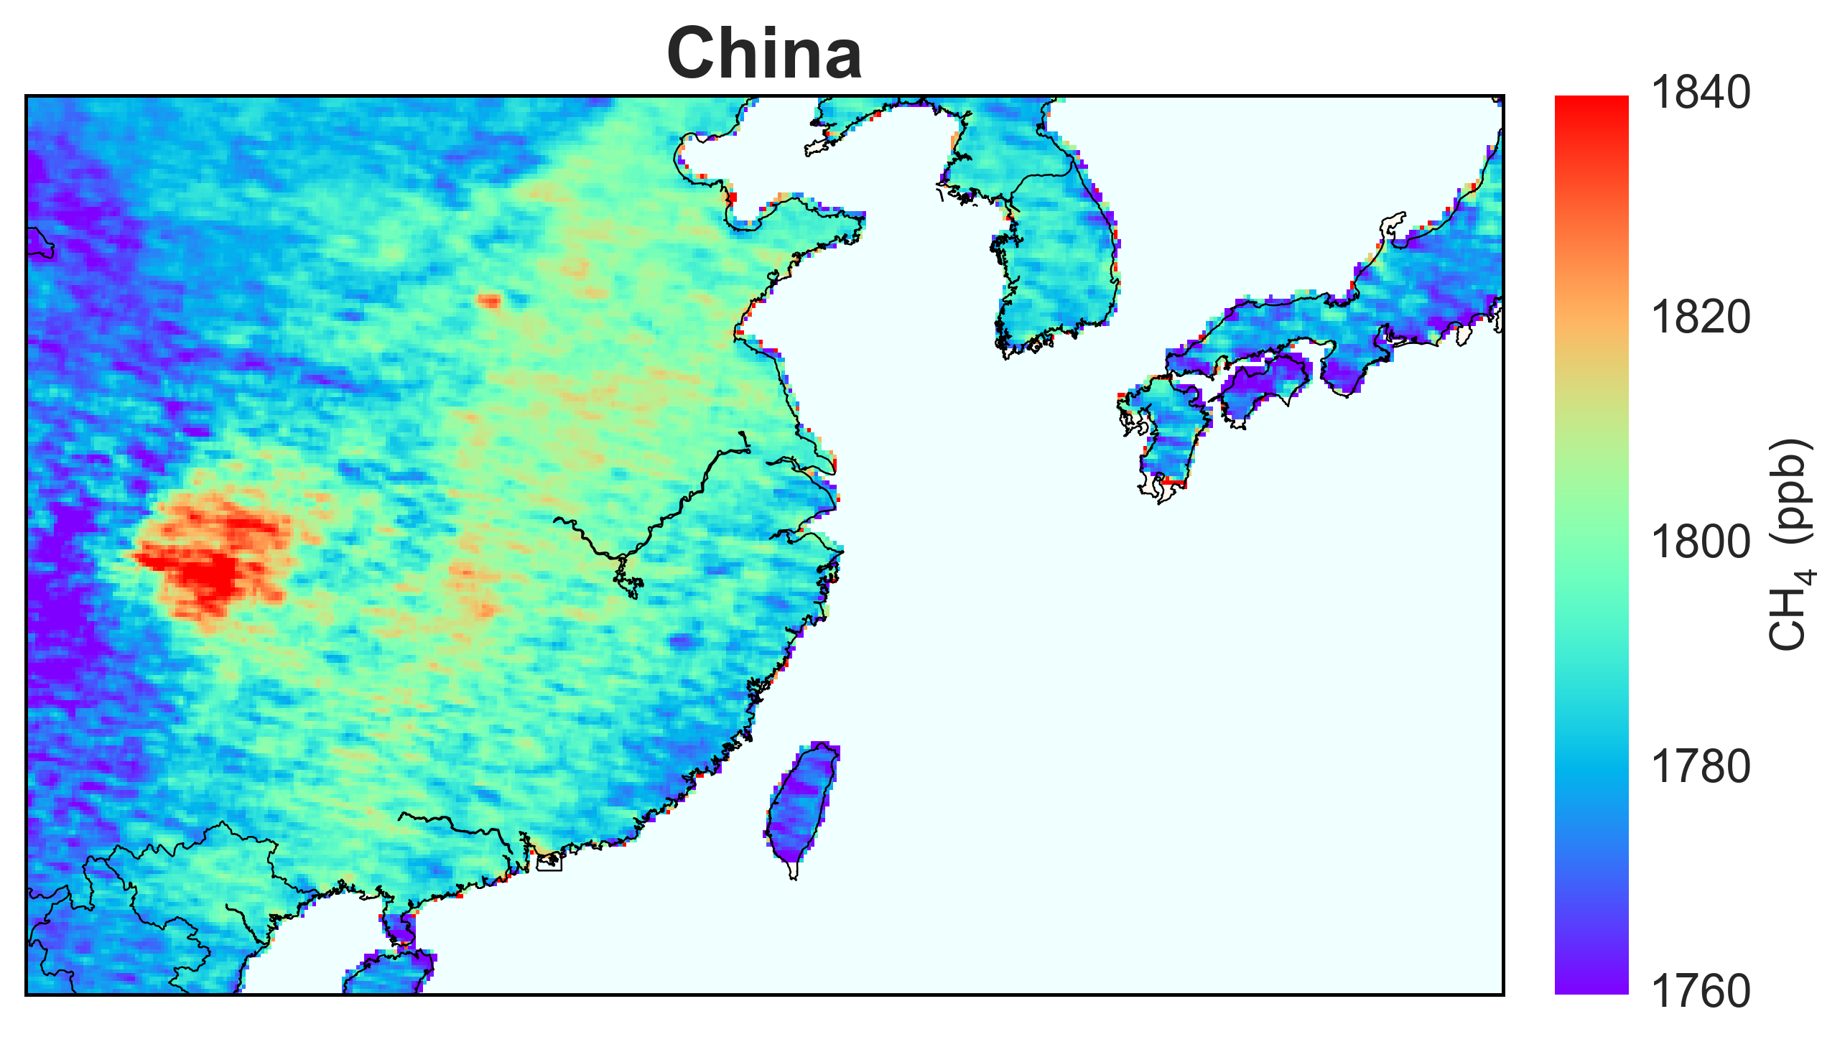
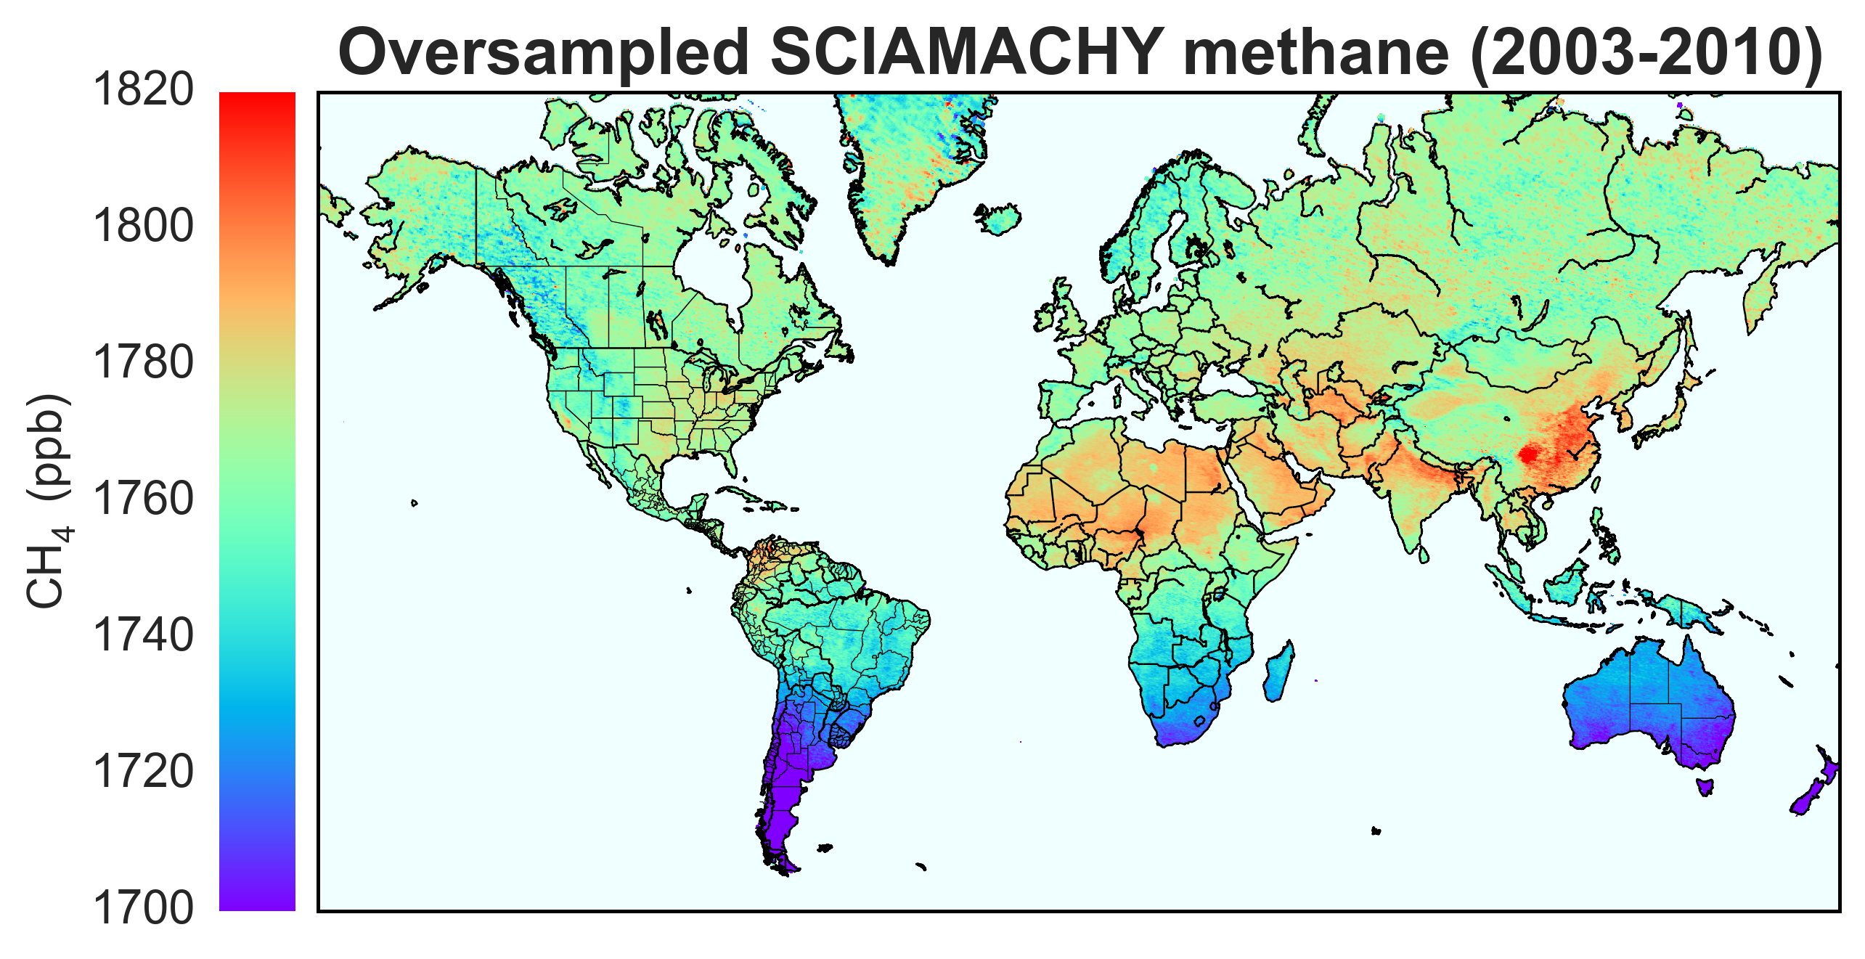
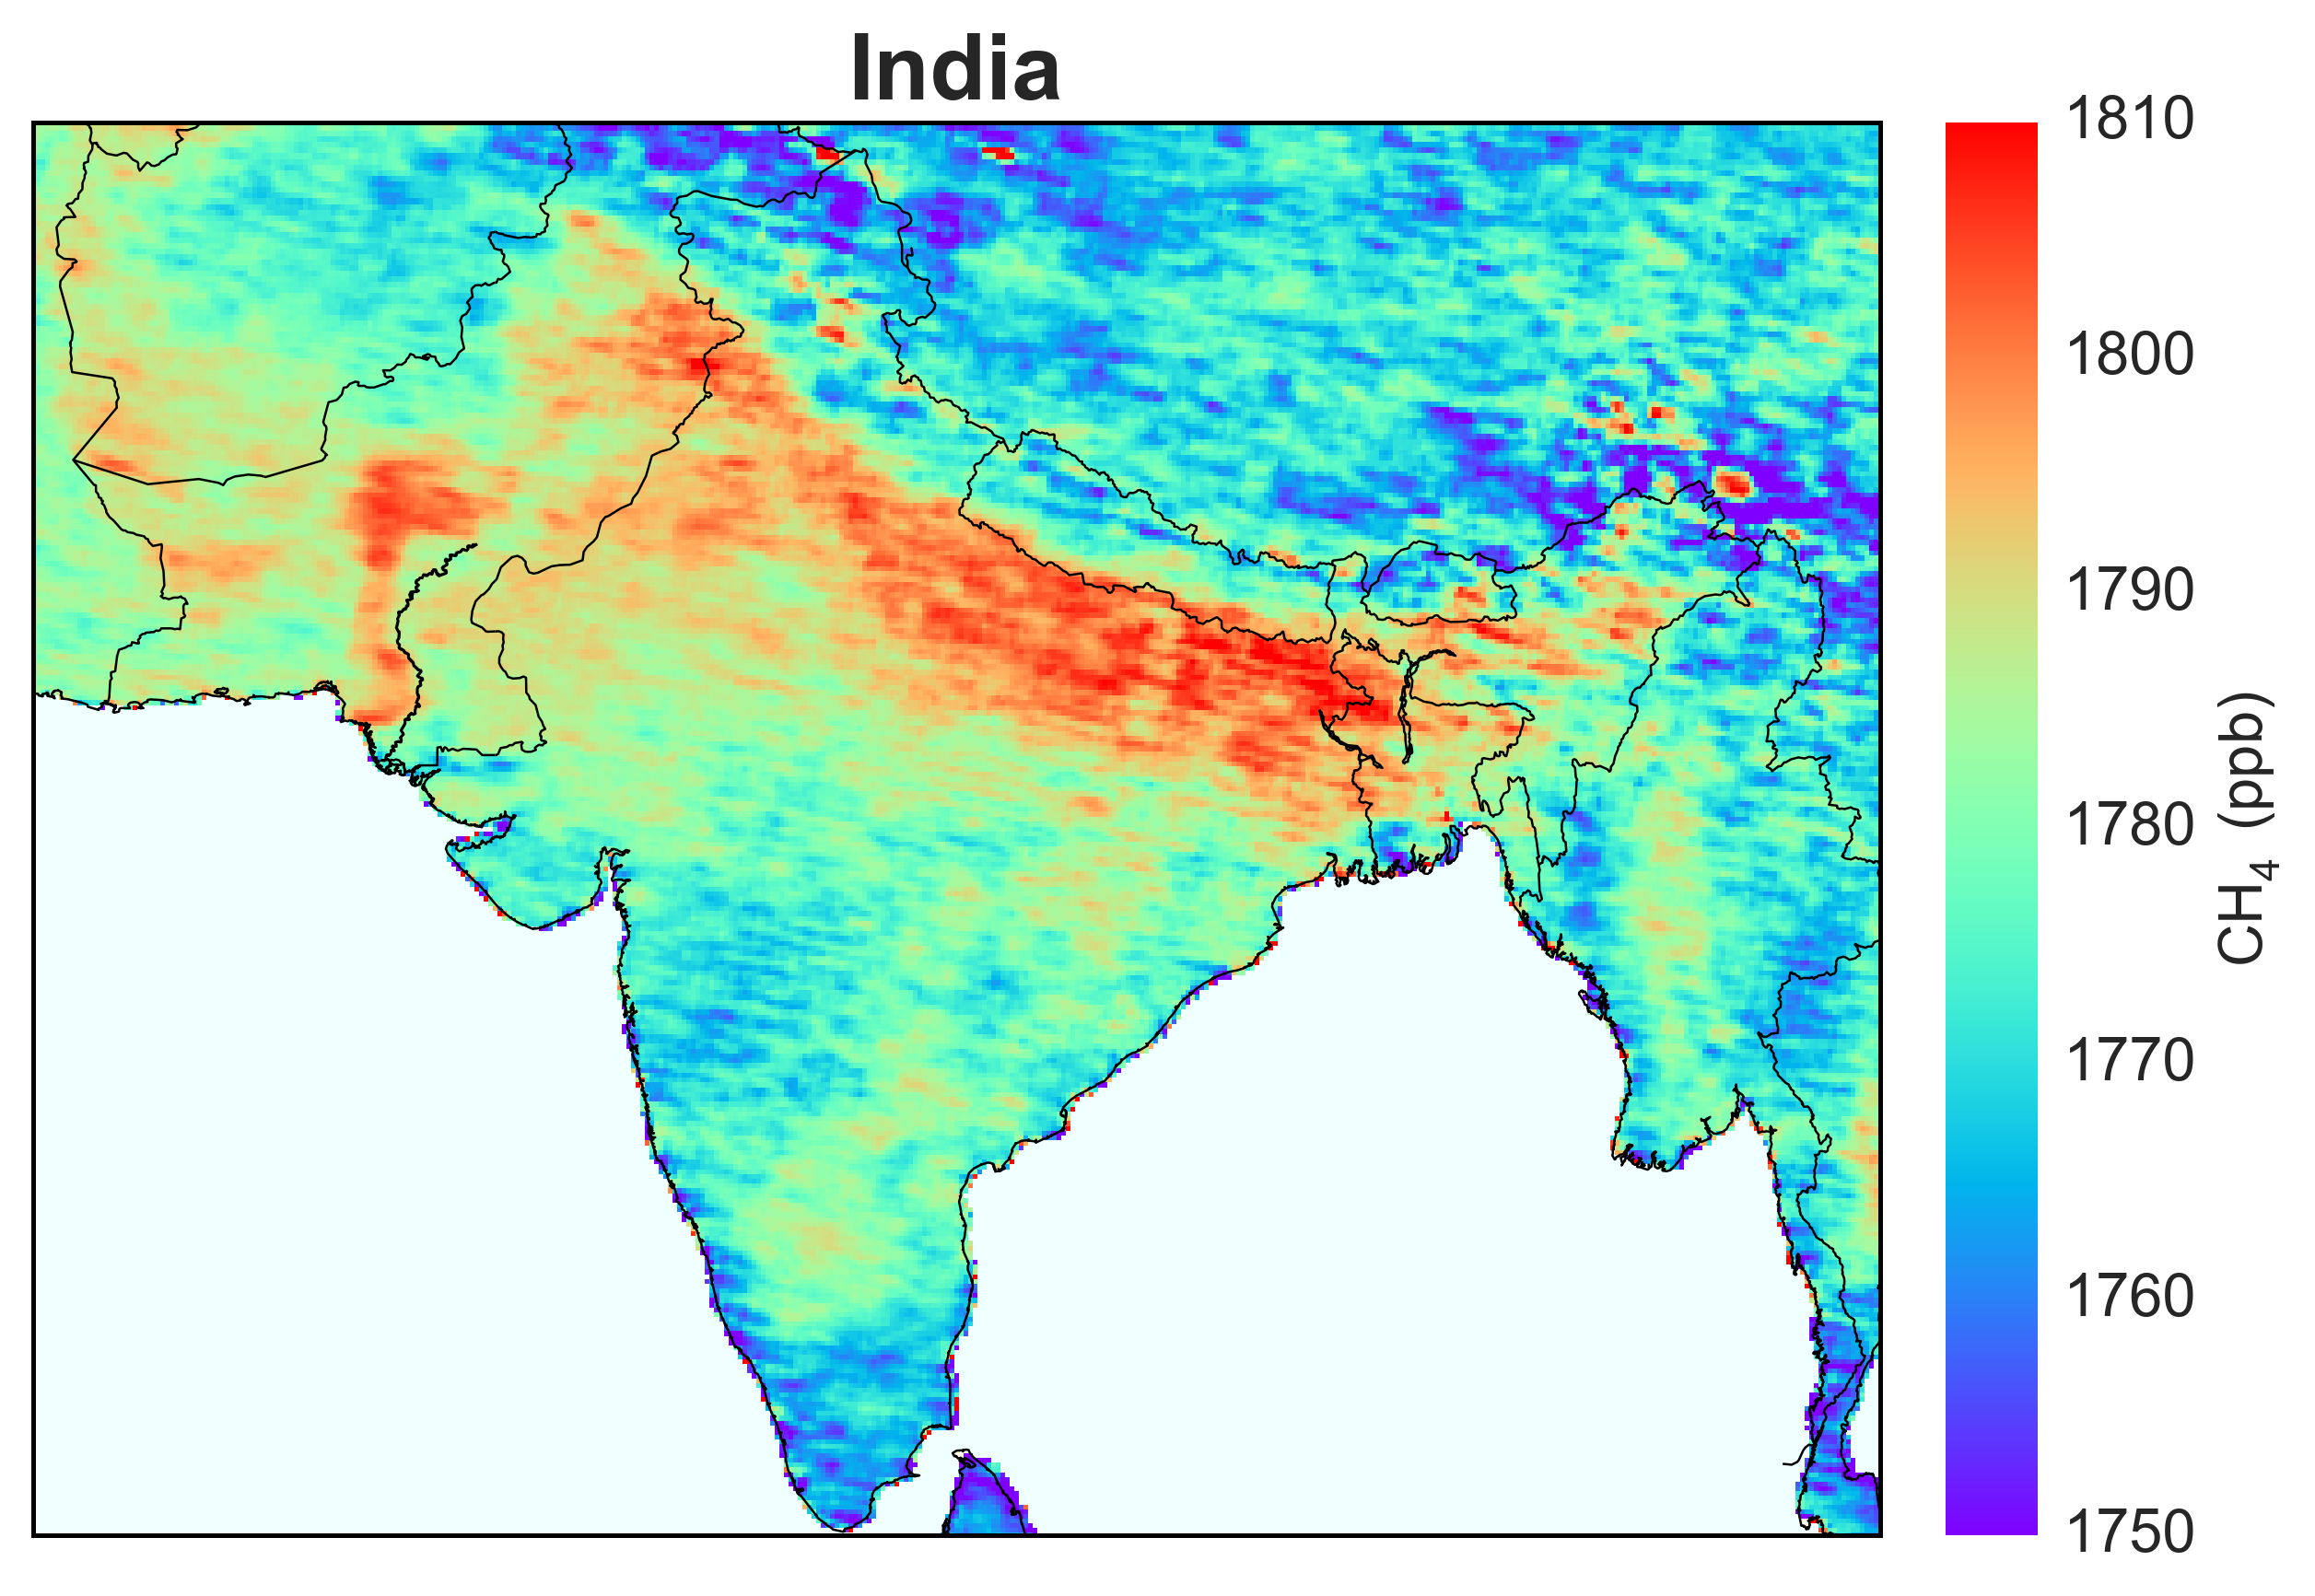
Notes:
Mapping of methane from space by oversampling of SCIAMACHY data, 2003-2010. The SCIAMACHY satellite instrument (2003-2012) provided dense but coarse-resolution global observations of methane. An oversampling method is used here to display SCIAMACHY data with 0.1ºx0.1º grid resolution by temporal averaging of partially overlapping pixels. The map identifies major point and regional sources of methane worldwide. From Joannes Maasakkers, Lei Zhu, and Daniel Jacob (Harvard).

Slide 5
Notes:
Video URL: https://carbon.nasa.gov/hyperwall/jacob/3_methane_turner_2015_1080p.mp4
Global and North American inversions of methane emissions using GOSAT satellite data. Satellite observations of atmospheric methane provide a powerful resource for improving our knowledge of methane emissions. The top panel shows a global simulation of methane by the GEOS-Chem chemical transport model using prior knowledge on methane emissions from the EDGAR anthropogenic inventory and the LPJ wetlands inventory. The middle panel shows GOSAT satellite observations of methane. Differences between the GOSAT observations and the prior GEOS-Chem simulation point to the need for correcting emissions, with proper accounting of errors. The bottom panels show the correction factors from a Bayesian inversion of 2010-2011 GOSAT observations and the resulting GEOS-Chem simulation using these posterior emissions. The inversion is done at 4ºx5º resolution on the global scale and at 0.5ºx0.625º on the scale of North America. From Turner et al. [2015].
Turner, A.J., D.J. Jacob, K.J. Wecht, J.D. Maasakkers, E. Lundgren, A.E. Andrews, S.C. Biraud, H. Boesch, K.W. Bowman, N.M. Deutscher, M.K. Dubey, D.W.T. Griffith, F. Hase, A. Kuze, J. Notholt, H. Ohyama, R. Parker, V.H. Payne, R. Sussmann, C. Sweeney, V.A. Velazco, T. Warneke, P.O. Wennberg, and D. Wunch Estimating global and North American methane emissions with high spatial resolution using GOSAT satellite data, Atmos. Chem. Phys., 15, 7049-7069, 2015.

Slide 6
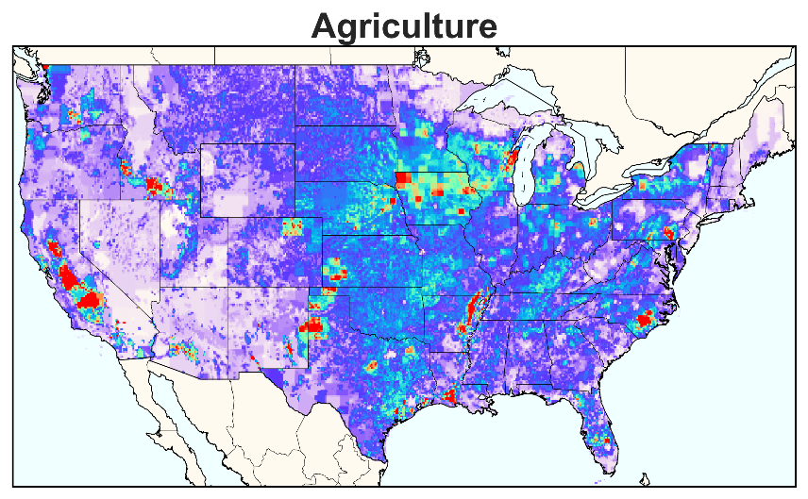
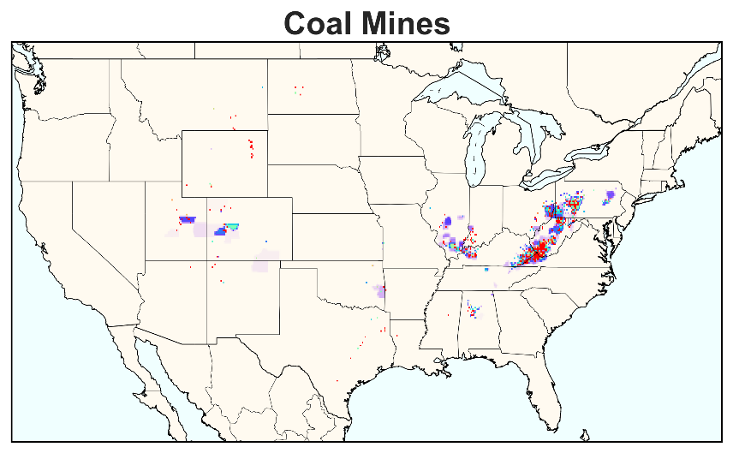
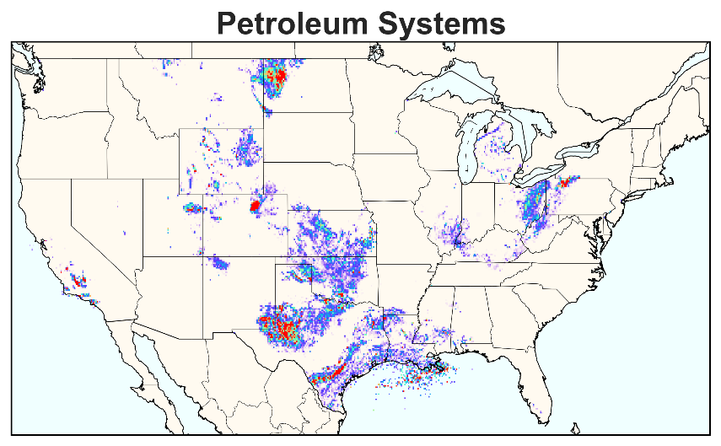
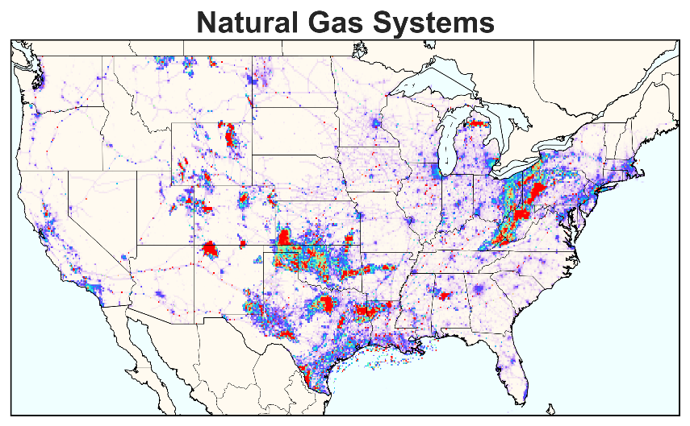
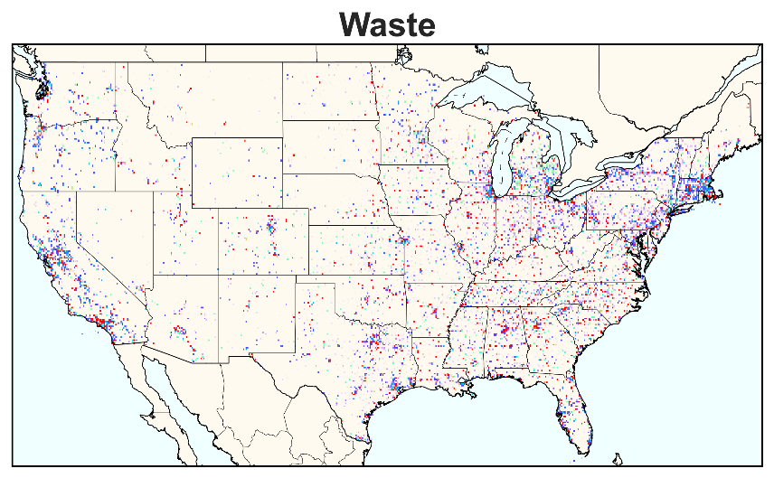
US EPA anthropogenic methane inventory
Other 0.8
Agriculture 9.7
Wastewater (0.6)
Waste 7.6
Enteric fermentation (6.7)
Landfills (6.9)
Distribution (0.5)
Manure (2.5)
Rice (0.5)
Transmission (1.1)
Coal 2.9
Processing (0.9)
Underground (2.2)
Natural gas 6.9
Surface (0.5)
Abandoned (0.2)
Production (4.4)
Onshore (2.1)
(All values in Tg a⁻¹)
Offshore (0.2)
Petroleum 2.3
Notes:
A new gridded inventory of US anthropogenic methane missions. The inventory is based on the US EPA Greenhouse Gas Inventory [US EPA, 2016] reported to the United Nations Framework Convention on Climate Change (UNFCCC). The EPA inventory includes detailed sectoral information (pie chart, for 2012 emissions) but no spatial information. The gridded version of the EPA inventory disaggregates the national totals for individual sectors by using a large ensemble of datasets for activity rates and emission factors. It enables the use of the EPA inventory as prior estimate in inversions of atmospheric methane, and paves the way for using these inversions to improve the inventory. The maps show the distribution of emissions from the five major broad source categories. From Maasakkers et al. [2016]
US Environmental Protection Agency, Inventory of US Greenhouse Gas Emissions and Sinks: 1990-2014, available at: epa.gov/ghgemissions/ inventory-us-greenhouse-gas-emissions-and-sinks-1990-2014 , 2016.
Maasakkers, J.D., D.J.Jacob, M.P. Sulprizio, A.J. Turner, M. Weitz, T. Wirth, C. Hight, M. DeFigueiredo, R. Schmeltz, L. Hockstad, A.A. Bloom, K.W. Bowman, S. Jeong, and M.L. Fischer, A gridded national inventory of US methane emissions, Environ. Sci. Technol., in press.

Slide 7
Notes:
Video URL: http://carbon.nasa.gov/hyperwall/jacob/5_methane_wetlands_1080p.mp4
Methane emission from wetlands, 2001-2016. Wetlands are the main natural source of methane, amounting to about one third of present-day methane emissions. This animation shows monthly wetland emissions from the average of an ensemble of process-based inventories that relate wetland emissions to inundation, precipitation, carbon availability, and carbon respiration. There are large seasonal variations driven by inundation and temperature, and climatically-driven interannual variability that must be accounted for when interpreting the observational record of atmospheric methane. From Bloom et al. [2016].
Bloom, A.A., K.Bowman, M. Lee, A. J. Turner, R. Schroeder, J. R. Worden, R. Weidner, K. C. McDonald, and D. J. Jacob, A global wetland methane emissions and uncertainty dataset for atmospheric chemical transport models, Geosci. Model Dev. Discuss., doi:10.5194/gmd-2016-224, 2016.

Slide 8
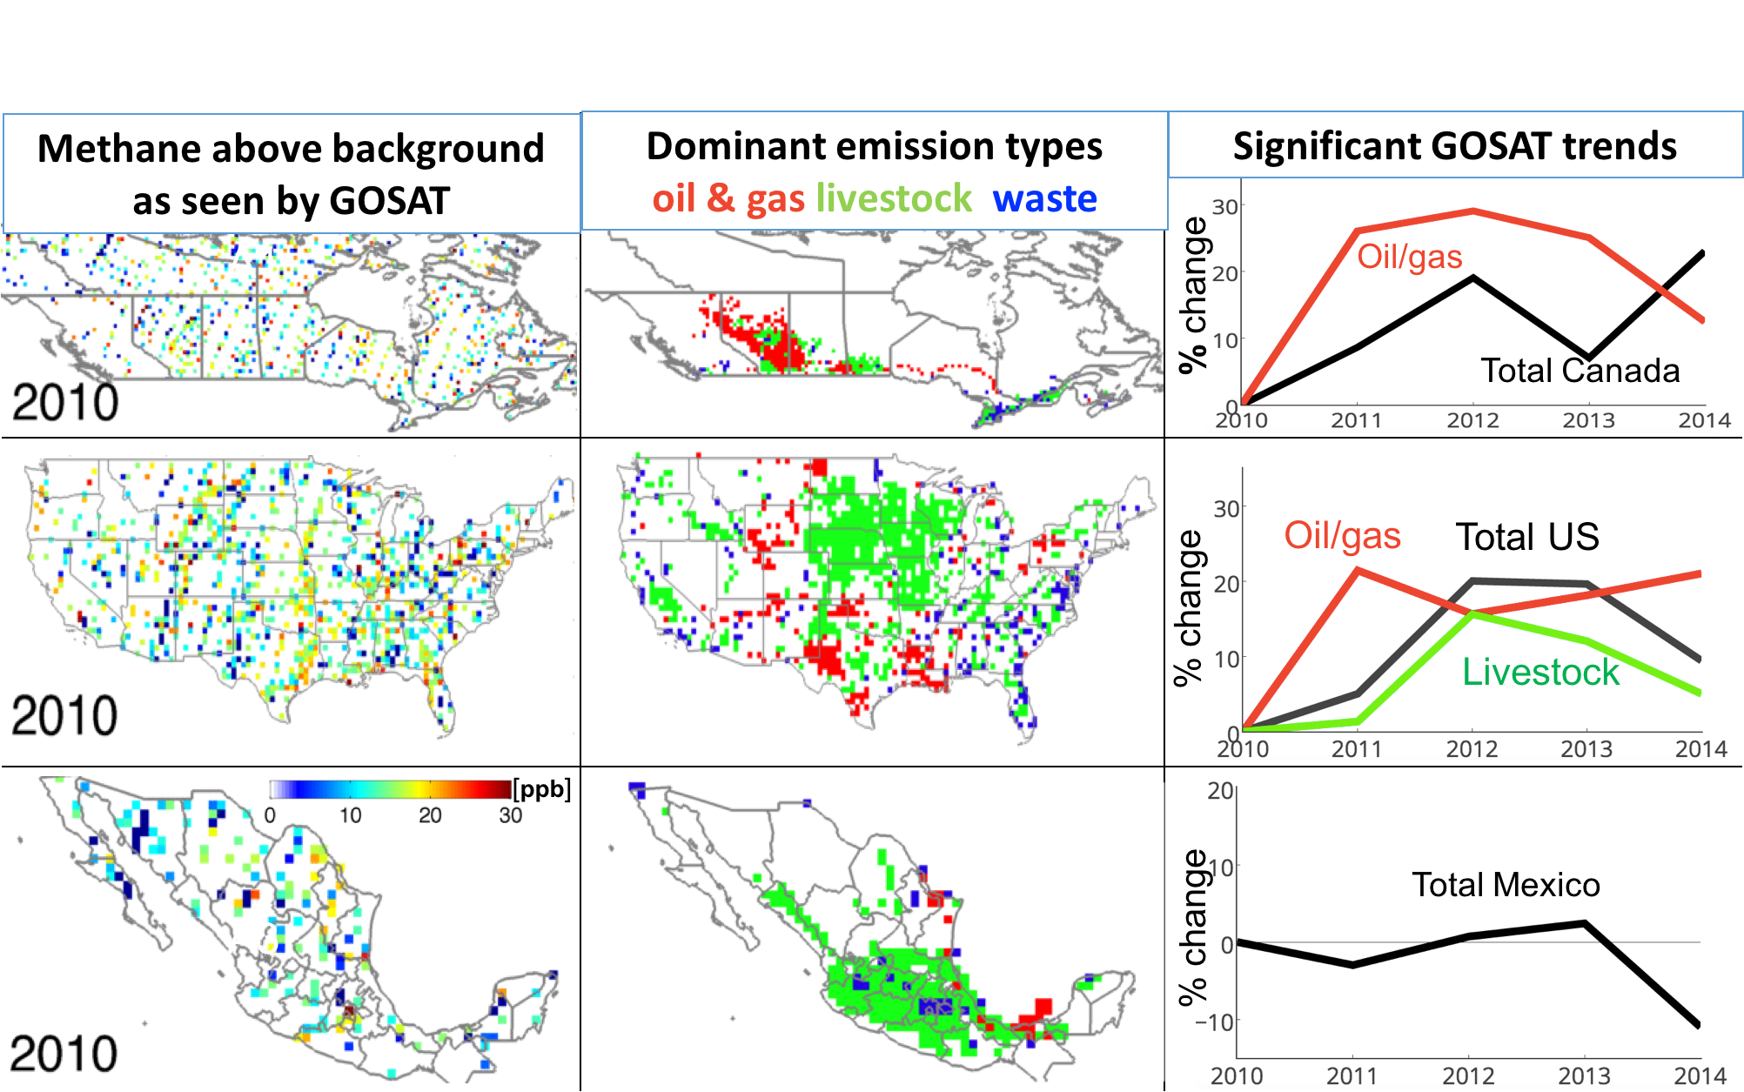
Notes:
Video URL: http://carbon.nasa.gov/hyperwall/jacob/6_methane_na_trends_1080p.mp4
2010-2014 trends in North American methane observed by GOSAT. The left panels show annual mean methane enhancements above background in Canada, the US, and Mexico as observed by GOSAT. The middle panels show locations of dominant methane source types as identified by new bottom-up inventories {Maasakkers et al., 2016; Sheng et al., 2016]. The right panels show the national trends in emissions since 2010 seen by GOSAT, and (when significant) the contribution from specific source types as informed by the spatial distribution of trends in relation to the bottom-up inventories. From Jianxiong Sheng, Joannes Maasakkers, and Daniel Jacob (Harvard)
Maasakkers, J.D., D.J.Jacob, M.P. Sulprizio, A.J. Turner, M. Weitz, T. Wirth, C. Hight, M. DeFigueiredo, R. Schmeltz, L. Hockstad, A.A. Bloom, K.W. Bowman, S. Jeong, and M.L. Fischer, A gridded national inventory of US methane emissions, Environ. Sci. Technol., in press.
Sheng, J., et al., A high-resolution (0.1º × 0.1º) inventory of methane emissions for Canadian and Mexican oil and gas systems, submitted to Environ. Sci. Technol.

Slide 9
Notes:
Video URL: http://carbon.nasa.gov/hyperwall/jacob/7_methane_4_corners_1080p.mp4
Airborne remote sensing of methane point sources over Four Corners, New Mexico. The AVIRIS-NG airborne sensor maps methane plumes from point sources with 1-3 m pixel resolution. The Four Corners oil/gas field is the largest methane source in the US. Data from Frankenberg et al. [2016] show plumes originating from a pipeline leak (2), storage tanks (3, 4), well pads (5), a coal mine venting shaft (6), and gas processing plants (8). Large-eddy simulations (LES) of plumes show that the total mass of methane in the plume is related to the magnitude of emission in a way that is independent of meteorological conditions. From Christian Frankenberg (Caltech), Yi Huang and Yan Xia (McGill). Daniel Varon and Daniel Jacob (Harvard).
Frankenberg, C., A.K. Thorpe, D.R. Thompson, G. Hulley, E.A. Kort, N. Vance, J. Borchardt, T. Krings, K. Gerilowski, C. Sweeney, S. Conley, B.D.. Bue, A.D. Aubrey, S. Hook, and R.O. Green, Airborne methane remote measurements reveal heavy-tail flux distribution in the Four Corners region, PNAS, 113, 9734-9739, 2016.

Slide 10
Notes:
Video URL: http://carbon.nasa.gov/hyperwall/jacob/8_GeoSlide_2day_with_titles.mp4
Observing methane from space in the future. This animation illustrates the capabilities of different satellite instruments to map methane emissions from the Barnett Shale region of northeast Texas. This region features major methane emissions from oil/gas production, livestock, and landfills. The animations show two days of observations by GOSAT (2009-present), TROPOMI (2017 launch), and the geostationary GCIRI (proposed to NASA). During those two days, GOSAT has only one observation over the region. TROPOMI provides complete daily mapping at 1:30 pm local time but can be blocked by clouds. GCIRI provides complete hourly mapping with high pixel resolution, enabling notably the detection of so-called "super-emitters". The slide illustrates the tremendous future potential of TROPOMI and geostationary observations for mapping methane emissions. From Melissa Sulprizio and Daniel Jacob (Harvard).
Acknowledgements:
Daniel Jacob, Joannes Maasakkers, Jianxiong Sheng, Melissa Sulprizio, Alex Turner, Daniel Varon, Lei Zhu (Harvard);
Christian Frankenberg (Caltech); Anthony Bloom, Kevin Bowman (JPL); Yi Huang, Yan Xia (McGill)

